Slide 1
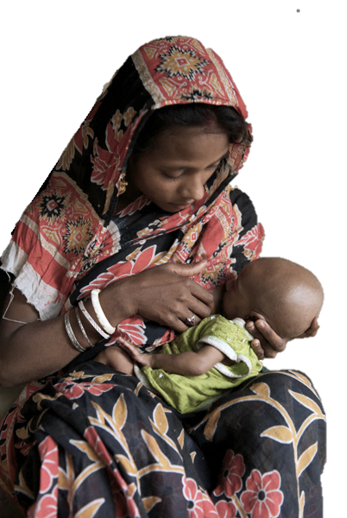
Nutrition Financing in Rajasthan: Trends and Gaps in 2016-2017

Slide 2
Overview of today’s presentation
Background
Methods and Results
Estimating multi-sectoral financing available for nutrition across all sectors and programmes
Estimating resource needs, current financing and funding gap for scaling the national priority ‘India Plus’ interventions
Policy Recommendations

Slide 3
Background
Despite progress, levels of malnutrition are still high in Rajasthan: of children
<5 years old, 36% stunted, 14% wasted
Malnutrition is a complex problem, with many underlying causes spanning multiple sectors of action
Nutrition is a government priority, but not the sole focus of any department; nutrition programmes fall in many budgets & are not tracked holistically
Further concerted action is needed to combat malnutrition in Rajasthan
Multi-sectoral perspective and coordination are essential
Multi-department analysis of nutrition financing needed, to track commitments and progress, and to identify options for improvement
Analysis is especially important in light of increased fiscal devolution
2014-2015
2015-2016
Tied transfers
Untied transfers
Tied transfers
Untied transfers
Nutrition funding from central sources
Nutrition funding from central sources

Slide 4
Multi-sectoral nutrition financing across all sectors and programmes

Slide 5
Approach and key findings
Core approach to financing analysis:
Identify (~200) nutrition-relevant programme line items in budgets, PIPs and supplementary budget materials, and extract the budget amounts
Categorise by sector, and whether nutrition-specific or nutrition-sensitive
Analyse patterns within budgets, and trends over time
Budget Head | Minor Head | Name | 2014-15 BE | 2014-15 RE | 2014-15 AE | 2015-16 BE | 2015-16 RE | 2016-17 BE | Sector | Nutrition-specific or -sensitive
2217 | 192 | Swachh Bharat Mission | 0 | 0 | 0 | 270000 | 2255194 | 2250979 | WASH | Sensitive
2225 | 196 | Food in Residential Schools | 75000 | 60000 | 60773 | 60000 | 95000 | 150000 | Social protection | Sensitive
… | … | … | … | … | … | … | … | … | …
Key findings:
Financing for nutrition-sensitive programmes is nearly 9x as large as for nutrition-specific programmes, and could be better leveraged
Budget allocations for nutrition-specific programmes are 13% lower today than before devolution, but higher than in 2015-16
Utilisation of nutrition-relevant budgets is poor, and particularly in WCD and MHFW, the key implementing departments for nutrition
There is a 69% funding gap to scale the core India Plus interventions fully
1
2
3
4

Slide 6
1
Financing for nutrition-sensitive programmes is nearly 9x as large as for nutrition-specific, and could be better leveraged
Nutrition programme types
Nutrition financing by type and sector (crores ₹)
10,092
10,092
Nutrition-sensitive programmes address the underlying causes of foetal and child nutrition, e.g.:
Other nutrition-sensitive schemes
1,037
MDM
709
National Food Security Mission
402
Food security
Adequate caregiving resources
Access to health services
Safe & hygienic environment
Other agriculture schemes
1,313
Nutrition-Sensitive
8,987 (89%)
WASH
3,131
Nutrition-specific programmes address the immediate causes of foetal and child nutrition, e.g.:
NHM (nutrition-sensitive share)
1,794
Adequate food & nutrient intake
Feeding, caregiving and parenting practices
Low burden of infectious disease
ICDS (nutrition-sensitive share)
599
1,106 (11%)
NHM
37
Nutrition-Specific
ICDS
1,069
2016-17 BE
2016-17 BE
Notes:
1. Full value of PDS not included here, as not available in state-level budgets. Based on analysis by Chakrabarti & Rajkhowa (2015), the approximate value of the PDS cereal subsidy in Rajasthan is 1,700 crores, before delivery costs

Slide 7
2
Budget allocations for nutrition-specific programmes are 13% lower today than before devolution - but higher than 2015-16
Financing over time for nutrition-specific and nutrition-sensitive programmes (crores ₹)
-6%
10,728
11,193
10,000
10,092
9,379
8,232
9,450
10,172
8,987
Nutrition-sensitive
8,373
8,932
7,258
-13%
1,278
1,006
975
1,068
1,022
1,106
Nutrition-specific
2014-15 BE
2014-15 RE
2014-15 AE
2015-16 BE
2015-16 RE
2016-17 BE
Pre-devolution
Transition to devolution
Post-devolution
Also signs of budget underutilisation in 2014-15

Slide 8
3
Utilisation in total ICDS and NHM was poor in 2014-15, despite their importance for delivering key nutrition programmes
Budgeted, revised and actual estimates for total ICDS and NHM, 2014-2015 (crores ₹)
Umbrella ICDS Scheme
National Health Mission
-27%
-41%
1959
2255
1809
1469
1421
1324
2014-15 BE
2014-15 RE
2014-15 AE
2014-15 BE
2014-15 RE
2014-15 AE
Averaged across all departments, actual estimates were only 11% lower than budget estimates

Slide 9
4
2,694 crores ₹ needed for India Plus; funding gap 1,847 crores ₹ (69%)
Excluding maternity benefits, 1,384 crores ₹ needed, with funding gap of 567 crores ₹ (41%)
Resource needs, financing and funding gap for India Plus in Rajasthan (crores ₹)
Micronutrients
and deworming
2,694
2,694
87
106
35
53
Health interventions
and counselling
Supplementation
1,847 (69%)
Funding Gap
Maternity benefits for breastfeeding mothers
847 (31%)
Available Financing
30
Total Resource Needs
Maternity Benefits for Breastfeeding Mothers
Supplementation
Health Interventions and Counselling
Micronutrients and Deworming
Total

Slide 10
Policy Recommendations

Slide 11
Analysis supports recommendations on three levels
Maintain momentum for nutrition and strive for
a coordinated multi-sectoral nutrition response
Expand impact of
nutrition-sensitive sectors
Maximize impact of
nutrition-specific programmes
ICDS
NHM
1
Agriculture
Water & Sanitation
Social protection
Education
Women’s empower-ment
…etc…
2
3

Slide 12
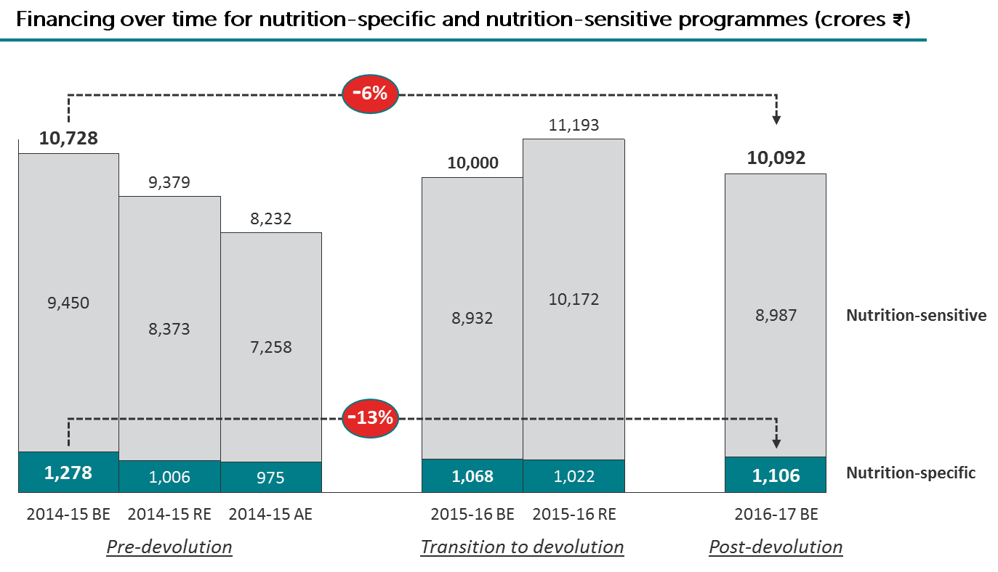
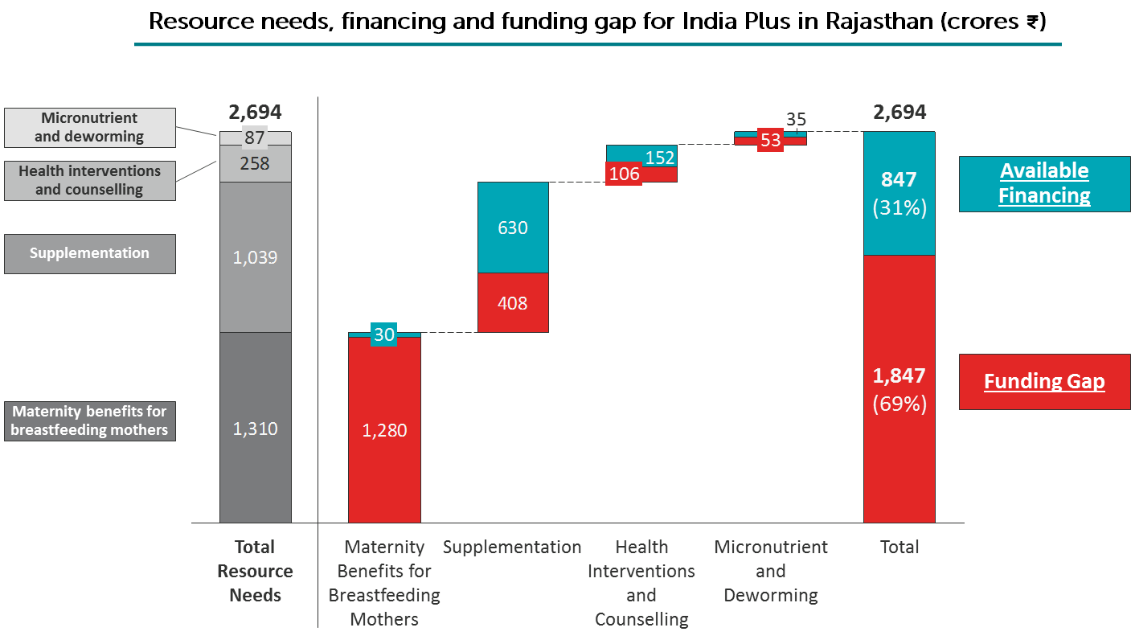
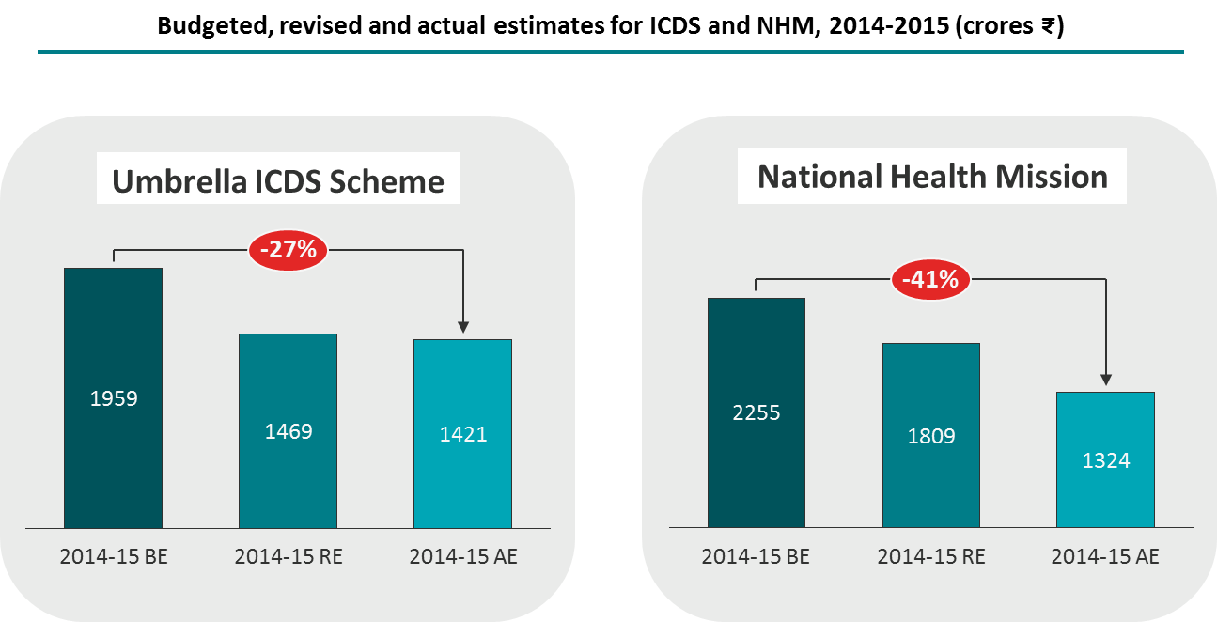
Maximize impact of nutrition-specific programmes
1
Findings from financing analysis
Nutrition-specific recommendations
Increase budget allocations for nutrition-specific programmes, and particularly
SNP and IGMSY under ICDS
Deworming, micronutrient interventions, and treatment of acute malnutrition, under NHM
Emphasize funding to support “first 1000 days” interventions, where impact of funds is greatest
Better utilise nutrition budgets, and reallocate any unused funds to other nutrition interventions

Slide 13
Expand impact of nutrition-sensitive sectors
2
Many sectors influence nutrition
Nutrition-sensitive recommendations
Improved nutrition
Agriculture
Social Protection
Women’s Empower-ment
Health
Education
WASH
Nutrition-sensitive departments can have more impact if they incorporate nutrition goals into their mandate
Nutrition-sensitive departments should enhance nutrition impact of key programmes, e.g.
Diversify and fortify food provided through TPDS
Increase funding for IEC in Swachh Bharat Abhiyan
Increase nutritional content of Mid-Day Meals
Nutrition-sensitive programmes make up nearly 90% of nutrition financing

Slide 14
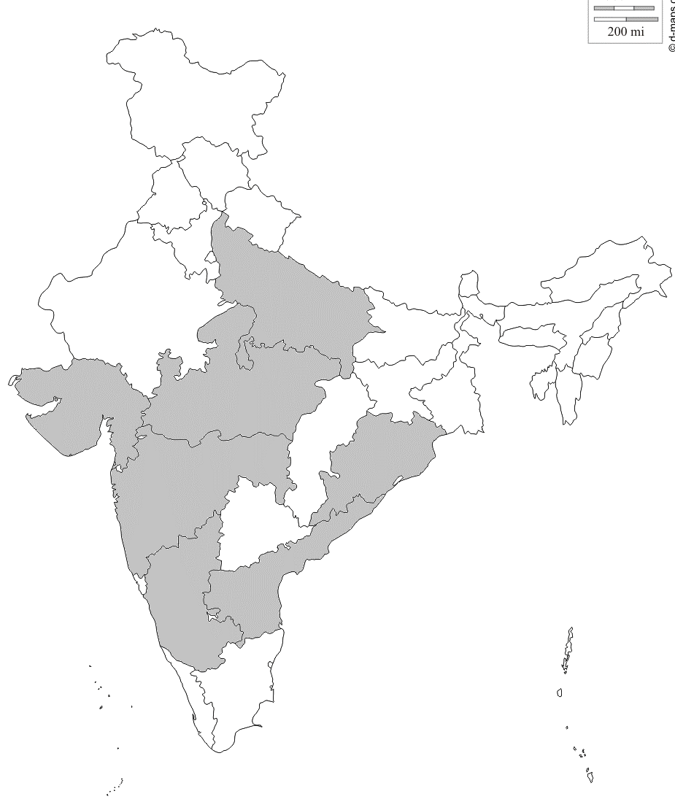
Maintain momentum for nutrition and strive for a coordinated multi-sectoral nutrition response
3
A state nutrition mission (SNM) could lead a broad nutrition response
Several states have already adopted
the SNM model for nutrition
An empowered and well-supported state nutrition mission could help to:
Mobilize additional resources for nutrition programmes
Support ongoing convergence efforts, and facilitate greater coordination with other nutrition-relevant departments, civil society and NGOs
Set nutrition targets for the state and track programmatic and financial progress
But, a SNM is not a panacea, and requires support from the top levels of government in order to succeed
Lessons can be learned from SNM experiences of other states before considering an SNM approach for Rajasthan

